Slide 1
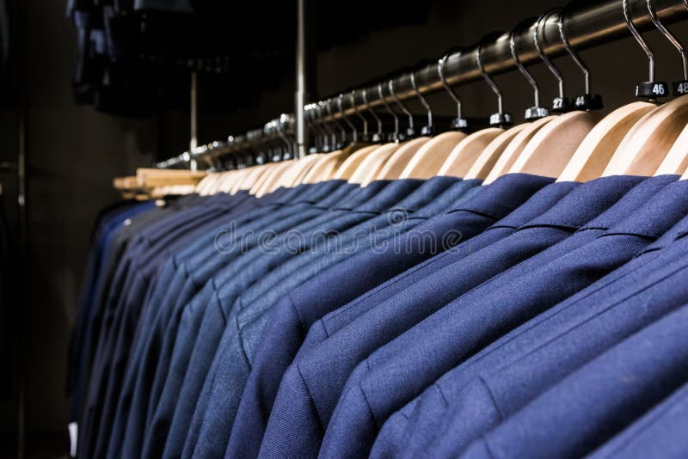

DIGITAL
MARKETING PROJECT

Slide 2
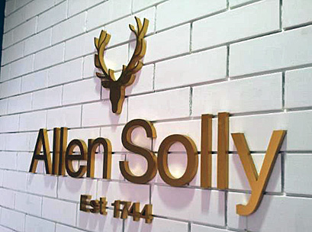
BRAND STUDY
RESEARCH BRAND
Allen Solly is known for its classy and stylish fashion at rock-bottom prices. Allen Solly was the first Indian brand to enter the shirts and jeans market officially. William Hollin founded Allen Solly and Co Ltd started in 1744. A firm called Madura Garments purchased the brand in the 1990’s. However, Allen Solly was purchased by the Aditya Birla Group in 2001.
In 2002, Allen Solly was the first Indian fashion brand to launch the “Friday Dressing” concept and it was an instant hit as office goers tried this new trend. A brand tagline, “My World, My Way”, was formed to underscore the brand’s latest trend.

Slide 3
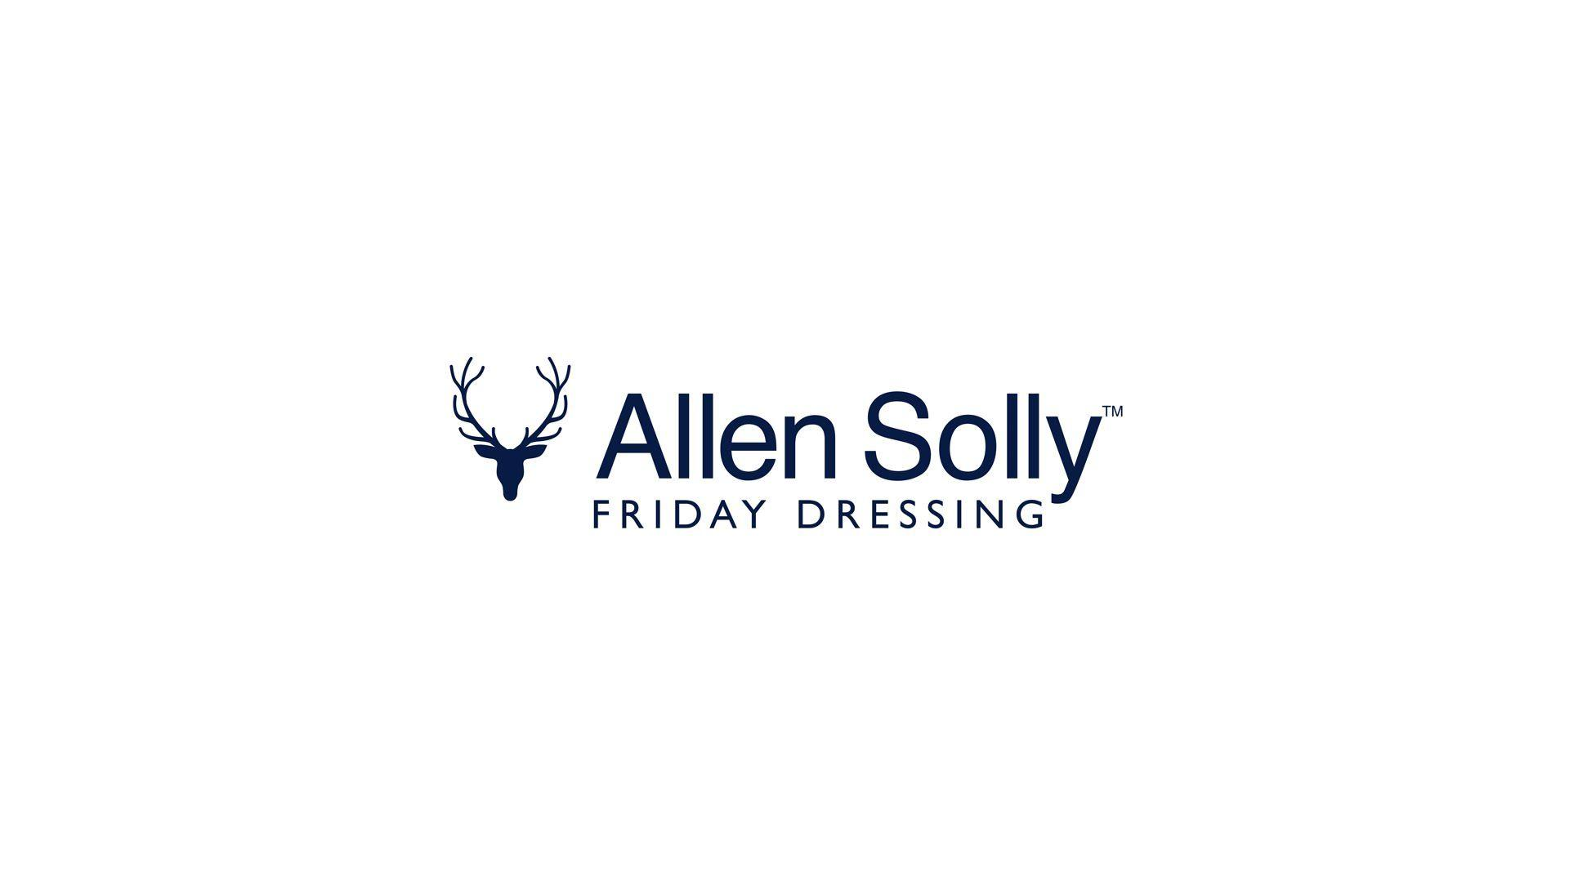
BRAND STUDY
MISSION
“To deliver superior value to our customers, shareholders, employees and society at large.”
USP
Stylish office wear.
BRAND TONE AND IDENTITY
Premium clothing brand and contemporary version of the stag from british roots.

Slide 4

COMPETITOR ANALYSIS
USP : Combines a redefined design with tailor-made fabrics.
ONLINE COMMUNICATION : Myntra, Amazon, facebook.
SWOT ANALYSIS OF VAN HEUSEN :-
STRENGTH : The brand has a wide category of clothing for both men and
women.
WEAKNESS : The brand has to deal with lot of pirated products.
OPPURTUNITY : The brand can increase global penetration into emerging
economies.
THREAT : Similar designs are available in market.

Slide 5
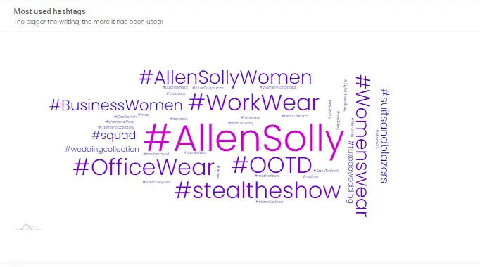
AUDIENCE PERSONA
KEY PERFORMANCE INDICATOR OF ALLEN SOLY
Conversion.
Average bill value.
Average basket size.
Average selling price.
TARGET AUDIENCE DEMOGRAPHIC AND INTERESTS
Urban Men Upper class and upper middle class are the target audience.
In general, customers are mostly interested into formal trousers, kids wear, polo t-shirts, party wear and track pants.

Slide 6

COMPETITOR ANALYSIS
USP : Combination of fashionable products and affordable prices.
ONLINE COMMUNICATION : Myntra, Amazon, Nykaa fashion.
SWOT ANALYSIS OF PETER ENGLAND :-
STRENGTH : It is a successful brand and has high recognition amongst
the people.
WEAKNESS : Has a restrictive global reach relative to other mnc’s.
OPPURTUNITY : The brand can expand its business to further grow
indian wear.
THREAT : Shifting government policies will have a major effect on
company.

Slide 7

COMPETITOR ANALYSIS
USP : Originally positioned as a brand for the youth.
ONLINE COMMUNICATION : Myntra, Flip kart, Shoppers stop.
SWOT ANALYSIS OF LOUIS PHILIPPE :-
STRENGTH : The collection are available at more than 1000 exclusive
and franchise store.
WEAKNESS : Because of high price the brand impacts on business
revenue.
OPPURTUNITY : Have tie-up with various international brands.
THREAT : Sale of duplicate products are increasing.

Slide 8
SEO KEY WORD SEARCH
NO. | KEYWORDS | VOLUME | KD%
1 | FORMALS | 205.0K | 92
2 | FOOTWEAR | 19.8K | 24
3 | KIDS WEAR | 34.0K | 88
4 | PARTY WEAR | 85.7K | 67
5 | TRACK PANTS | 28.2K | 49
6 | BLAZERS | 190.1K | 89
7 | TROUSERS | 93.6K | 75

Slide 9
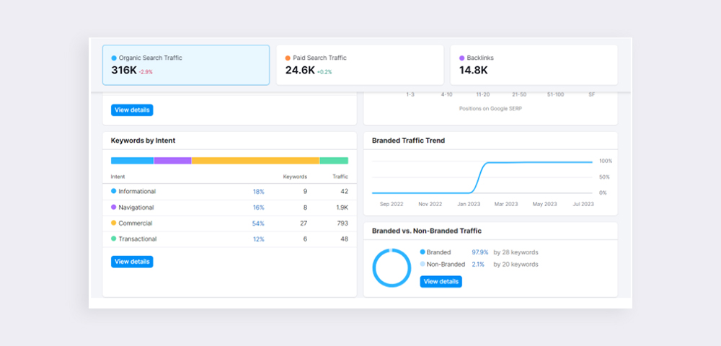
ON PAGE OPTIMIZATION

Slide 10
CONTENT IDEA AND MARKETING STARTEGIES
SUNDAY | MONDAY | TUESDAY | WEDNESDAY | THURSDAY | FRIDAY | SATURDAY
15 | 16 | 17 | 18 | 19 | 20 | 21
Created content | New Blogs | Post uploading | Webinar | Updated blogs | Group engagement | Product launch
22 | 23 | 24 | 25 | 26 | 27 | 28
Campaign | Facebook & instagram chat | Webinar | Campaign | Product launch | New blogs | Curated content
29 | 30 | 31
Story created | Target customers | Group engagement

Slide 11
MARKETING STRATEGIES
PRODUCT STATEGY :-
Allen Solly’s product lineup includes casuals, formals and kids wear. The company is known for its exclusive range of formals. The brand holds a prominent position in the market. Allen Solly has also collaborated with international designer Anju Modi.
PRICING STRATEGY :-
Ideas of “Friday dressing” were introduced to encourage active people to look cool in the office. The Aditya Birla Group’s supply chain network helped the company manufacture products quickly. The group has expertise in operations which helped to minimise its costs.

Slide 12
MARKETING STRATEGIES
PLACE AND DISTRIBUTION STRATEGY :-
The brand’s distribution network has too many on its list. It has retail, FMCG, manufacturing, business-to-business, financial and industrial sectors. Allen Solly has chosen metros, tier 1 and tier 2 cities for its targeted customer based on their needs and spending power.
PROMOTION AND ADVERTISING STRATEGY
The brand employs a variety of marketing methods to promote its products. One of the key methods is a corporate partnership, including the Azim Premji Foundation. Print media, online promotions, and pre-Friday debuts are all strategies. One of its popular social media campaign is, #ShootForSolly was aphotography project that linked 11 prominent people from all areas of life with 11 inspiring photographers.

Slide 13
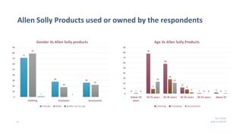
SEO AUDIT

Slide 14
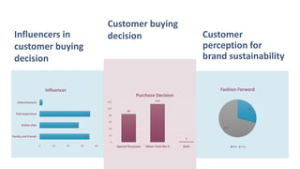
BRAND AUDIT

Slide 15
CONTENT CREATION
FORMAT 1:-
https://www.instagram.com/s/aGlnaGxpZ2h0OjE4MzA2Njg0NTc0MTg3ODk3?story_media_id=3212497054756336325_62319340218&igshid=MzRIODBiNWFIZA==

Slide 16
CONTENT CREATION
FORMAT 2:-
https://www.instagram.com/s/aGlnaGxpZ2h0OjE4MTM5Mzc3?story_media_id=3212497752881580614_62319340218&igshid=MzRIODBiNWFIZA==

Slide 17
CONTENT CREATION
FORMAT 3:-
https://www.instagram.com/s/aGlnaGxpZ2h0OjE4MDAxMDM5Mzl4MTM5Mzc3?story_media_id=3212497686913417014_62319340218&igshid=MzRIODBiNWFIZA==

Slide 18
POST CREATION
https://www.instagram.com/p/CyVGmZevSGcJltm4s-dkMX1s9bcuhNLoehTsAI0/?igshid=MzRIODBiNWFIZA==
https://www.instagram.com/p/CyU2qhFPMWbaB86FTOZiRRRlbYlt38fm5Y16al0/?igshid=MzRIODBiNWFIZA==

Slide 19
TEAM MEMBERS & ROLES
T. Sai Sriya ( TL) – ROLE : seo & keyword reaserch , content idea and marketing strategies , content creation, on page optimization .
I have done seo & keyword research , content idea and market strategies with the help of google and other websites, I created Instagram account , post , carousel, highlights .
S . Renuka – ROLE : brand study , competitor analysis
I have done brand study analysis ,competitor analysis,with the help of google .
B . Ganesh - ROLE : content idea& marketing strategies
I have done work on content creation & marketing strategies.
CH.Prabhu kumar - ROLE: On page optimization, SEO audit & Brand audit.
I have done work on SEO audit & brand audit with the help of google.

Slide 20
THANK YOU
PRESENTED BY
T.SAI SRIYA
RENUKA SEERA
CH.PRABHU KUMAR
B.GANESH

